Slide 1
Who are we:
UG 4th year students of IET DAVV Indore Madhya Pradesh.
Team members:
Ashutosh Halwai
Achal Athale
Apoorv Gupta

Slide 2
Thrust Areas:
How to ensure that Vaccine Transportation is as per the route plan and safe.
Development of Logistic Management Information System for end to end logistic, supply chain and inventory management of vaccine

Slide 3
Introduction
As on short time ,we have generated a basic prototype.
To fully understand the problem statements , We have done our research on current vaccine distribution plan and its associated factors.(attached at last)
The prototype is being rushed as demo to meet deadline.

Slide 4
Overview of Technology Involved
Blockchain as Backend.
Smart contract .
Python
Flask
Sawtooth hyperledger
Android/IOS using flutter
IOT devices ,gps module , Temp monitoring module.

Slide 5
Why blockchain and smart contracts.
As per our research the current system is flawed by the use of centralized system.
To address frauds in private distribution/government distribution having a decentralized system is a must.
This will enforce authenticity, credibility and trust for the vaccine in people.
No one in immense power/admin will be able to change or manipulate data.
Blockchain offers an immutable, decentralized database that can help all parties be sure that vaccine supplies are being stored and handled properly.
It is not owned by anyone, but rather provides a generic standardized protocol that all participants along the supply chain can join and share relevant data
It is immutable, therefore existing information cannot be deleted, only appended, which consequently drives a higher level of accountability by each participant that writes new data

Slide 6
There is the logistical challenge of temperature control throughout a complex supply chain and monitoring to ensure that vaccines are kept cold.
Coordinating supply with time-sensitive second doses of the vaccine will be one key application.
With every vaccine monitored over the blockchain, each link along the chain could keep track of the entire process, and health departments could monitor the chain as a whole and intervene, if required, to ensure proper functioning:
Manufacturers could track whether shipments are delivered on time to their destinations
Distributors would provide a more efficient delivery tracking platform, including storage requirements verifications, and would be the first to know and notify if things go wrong
Hospitals and clinics could better manage their stocks, mitigating supply and demand constraints. Furthermore, they would get guarantees concerning vaccine authenticity and proper storage conditions
Individuals would have an identical guarantee for the specific vaccine they receive

Slide 7
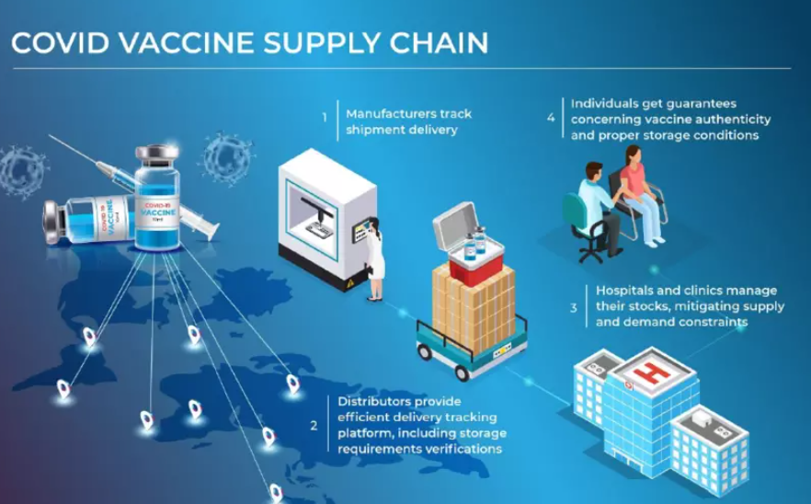

Slide 8
A solution that involves tracking of vaccine vial from its manufacturing to the its beneficiary.
We want to propose the network of blockchain which provides immutability to the vaccine information such as tracking, path, temperature monitoring to avoid frauds.
We have done a lot of research on what is the current to vaccination procedure in India thing is that when vaccine is being delivered from the government it is mostly monitored and controlled through E-vin systems but it is only for stationery fridge boxes/cold boxes.
To curb frauds in private distribution of vaccine where it is not monitored by any government us to maintain its efficacy to the last point to the beneficiary tracking of vaccine from manufacturing to the beneficiary is a must and it's credibility is at most thing to care because one's life depend on it will live or die.
Solution: a logistic management information system based on blockchain network. the parts of it will be various manufacturer of the vaccines tell the vaccine vans the decrease it and it enabled refrigerator box or refrigeration unit .

Slide 9
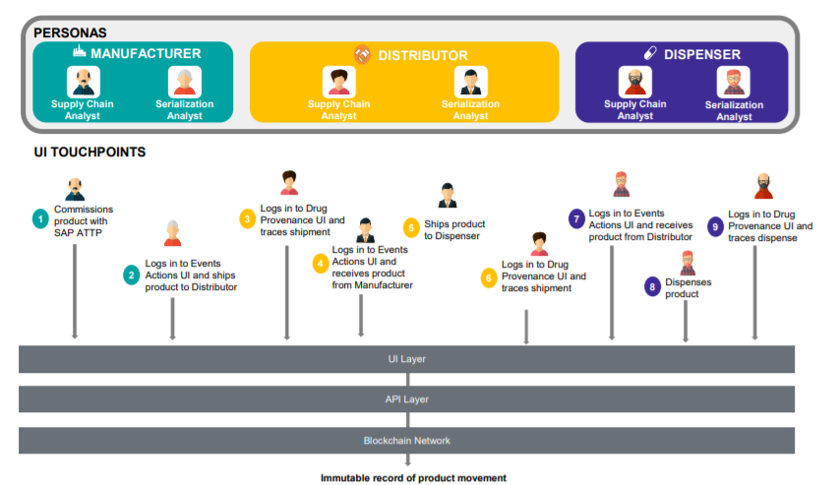

Slide 10
Iot enabled refrigeration unit which could be a refrigerator or a cold box, it will have battery operated iot device which will constantly a monitor the temperature off that you refrigeration unit in constantly reporting it to the blockchain network .The refrigeration unit will have iot devices having temperature monitoring device, GPS module, access module using a SIM enabled communication.
The part of off the network will be the manufacturers distributors vaccinator handlers and warehouse depositors, f beneficiaries doctors and common people.
Vidhi system we want to create a transparency see that person who is being vaccinated can touch the vaccine is authentic and credible by scanning a barcode over the vaccine.
When the vaccine vial is being manufactured it will have a unique QR code printed on the vial containing the required information of the vial. The system will contain large cold boxes for the refrigeration units will have a battery operated iot device . The device will provide GPS tracking access control temperature monitoring if any temperature change then smart contract will already automatically notified the district immunization officer or the person responsible.

Slide 11
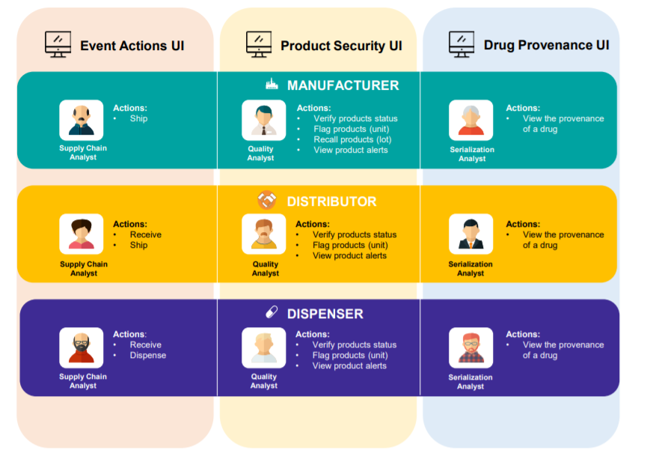

Slide 12
To enforce transparency and trust over the vaccine network. Blockchain based network will be followed. The nodes of the network will be at each state and the manufacturers.
Means decentralization of the vaccine data.
Anyone can scan the vaccine and see its history where it has been and temperature cycle to ensure credibility of the vaccine.

Slide 13
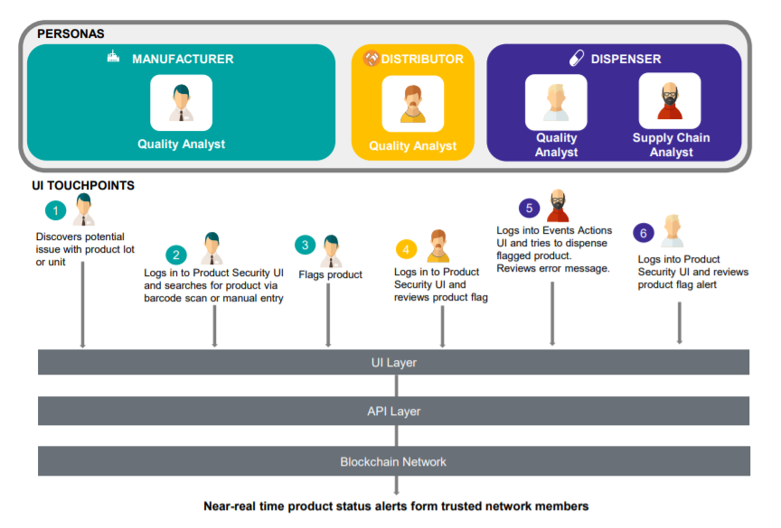

Slide 14
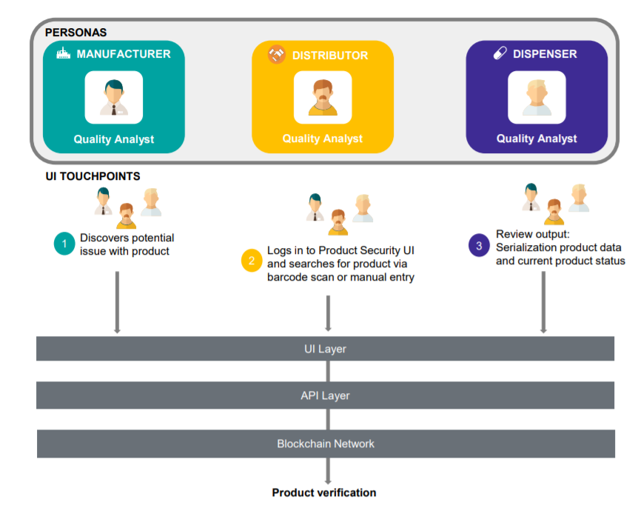

Slide 15
The end to end supply chain tracking will be done through blockchain network and using smart contracts to meet the constraints.
Q .Have you applied for multiple problem statements? What is the linkage you have for the same, please provide information for each of them
Ans. This project will cover end to end delivery of vaccine, tracking and holding vaccine data.

Slide 16
Key Points
E-box (iot enabled)for vaccine storage and tracking while moving
All states and manufactures are a part of the network.
They will act as a node to blockchain network.
Actors will be the manufacturers, transporters, retailers ,distributers , cold chainpoint, government.
Each transfer of A batch of Vaccine between them will be a transaction(holding detailed data regarding both the parties).

Slide 17
Network Key terms
Node : A computing center holding the blockchain.
Manufacturers
Each state Govt
Center govt
Participants: Beneficiaries ,Retailers ,Distributers, Transporters , coldchain point.

Slide 18
Visibility of Network
Certificates will be given to the nodes of the network for who can write and who can read data.
Government: Generate Request for Vaccine in batches. Read/write
Manufacturers : Read/Write access to Create vaccine batch
Beneficiaries: Read access to the BlockChain Network

Slide 19
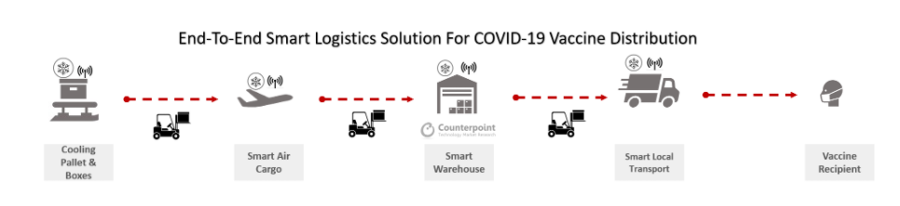
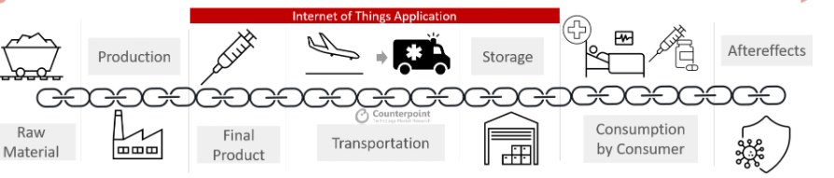

Slide 20
Vaccine Vials
Vaccine vials are produced and transported in batches.
Each Vaccine batch has an id and holding information of corresponding vaccines vails in it.
These information is digitally stored on Blockchain network.
The information is uploaded by the Manufacturer.

Slide 21
Transactions
Contents
Sender
Receiver
Time
Vaccine batch id
Vaccine Name
Quantity
Path

Slide 22
Electronic documentation
E-box will contain : IoT less,battery operated device consisting of
GPS module
Sim module
Temperature Module
Access Module

Slide 23
Have you applied for multiple problem statements? What is the linkage you have for the same, please provide information for each of them
Provide relevant attachments/videos/ppt to understand your Proposal/Product/Technology?
How will you scale your Technology? Briefly explain.
. Describe your approach to solve the problem statement and following regarding your solution?
a. Process Flow (Process Flow Diagrams may be leveraged for explaining)
b. Key Technology Involved
c. Solution Capabilities, Features & Specifications
d. Extent of Interoperability with existing technologies
e. Resource Requirement & Management
f. Platform Dependence

Slide 24
Example:
Vaccine manufactured in Ahmedabad. Vaccine vails are produced in batches of certain quantities . They are digitized and path is assigned to them.
Each Vaccine vails will have QR code and A transaction will be generated
Transferring Responsibility of vaccine batch to the transporter.
transporter : the IOT enabled box will store that batch of the vaccines.
IOT device will be lodged with the batch details

Slide 25
Th the smart contract will get activated lodging the location of the vaccine e box and its temperature from the manufacturer .The smart contract on blockchain will take path as input and will constantly track the location of the ebox and logging it into the blockchain.
When the ebox reaches a destination , A transaction will be created transferring the responsibility of that vaccine batch to the destination distributer.
From the distributer to the end point vaccination point: Where using the barcode it can be tracked from where it has been ,and temperature changes. Ensuring credibility of the vaccine for the beneficiaries.
As data is stored in blockchain its immutable. Any one wanting to alter or carry out malpractices will be caught.

Slide 26
The E box have access and connected to internet using sim ,any one in transit want to temper vaccine try to open the vaccine box/the unauthorized person access will be notified to concerned authorities,
No one can change this access as they are on block chain.
Constant monitoring of path logged by smart contract
Constant monitoring of temperature logged by smart contract to blockchain.

Slide 27
Why Blockchain?
To curb distrust against the vaccine in private sector.
Once record written cant be changed
Decentralized Network

Slide 28
Sample demo

Slide 29
Node View

Slide 30
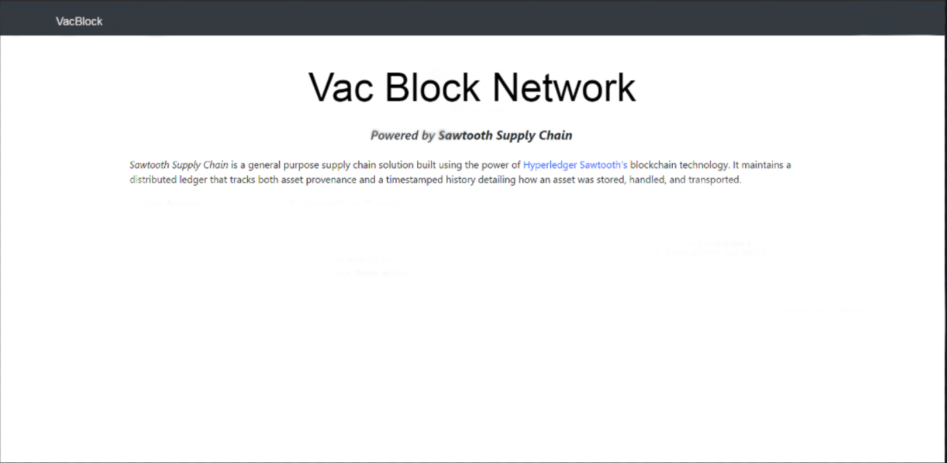

Slide 31
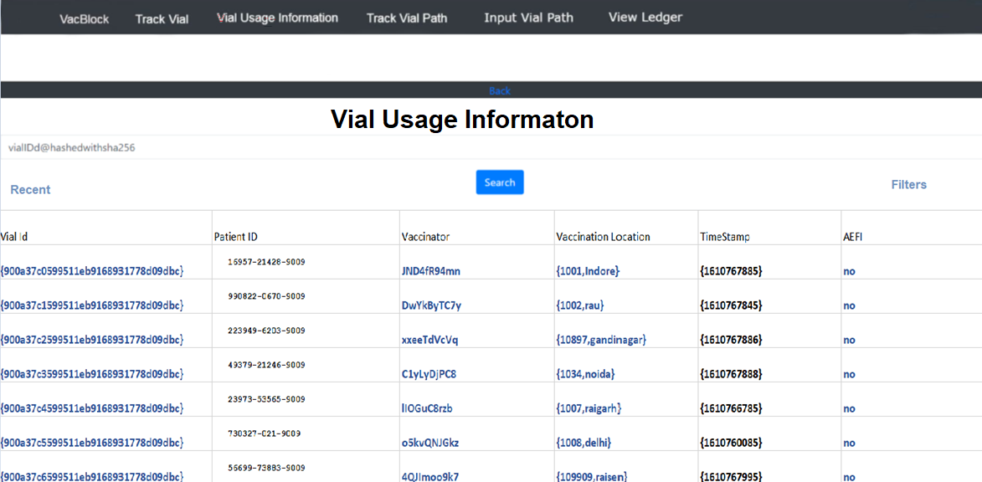

Slide 32
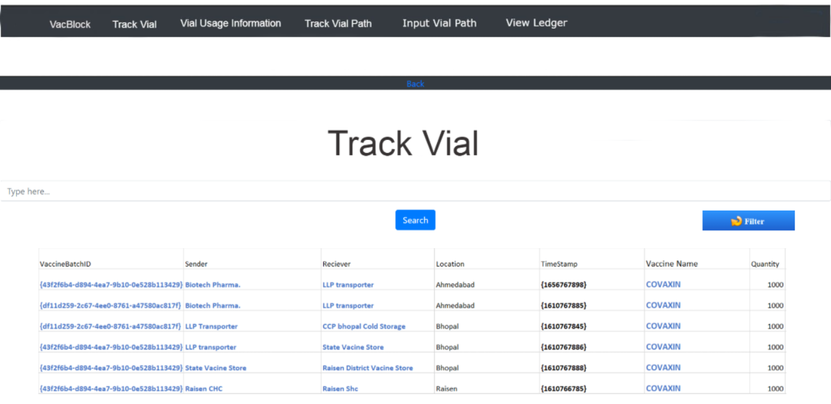

Slide 33
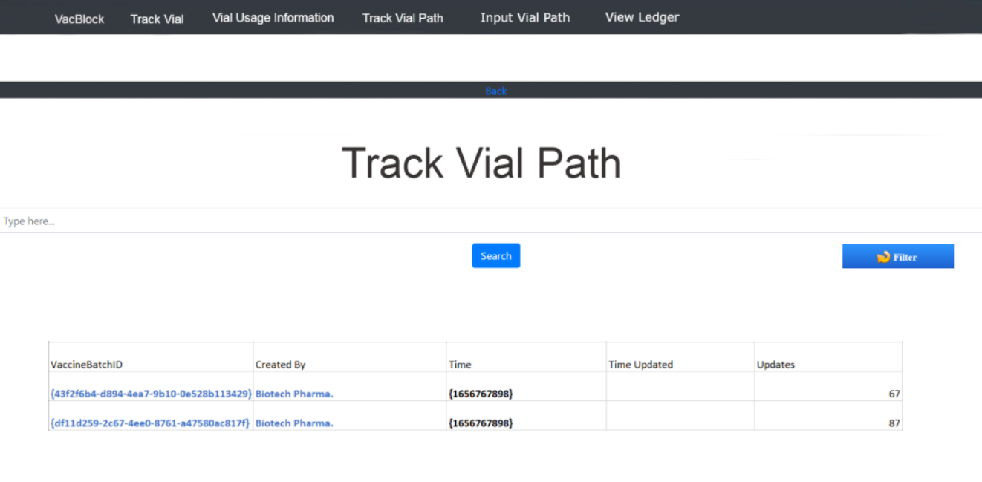

Slide 34
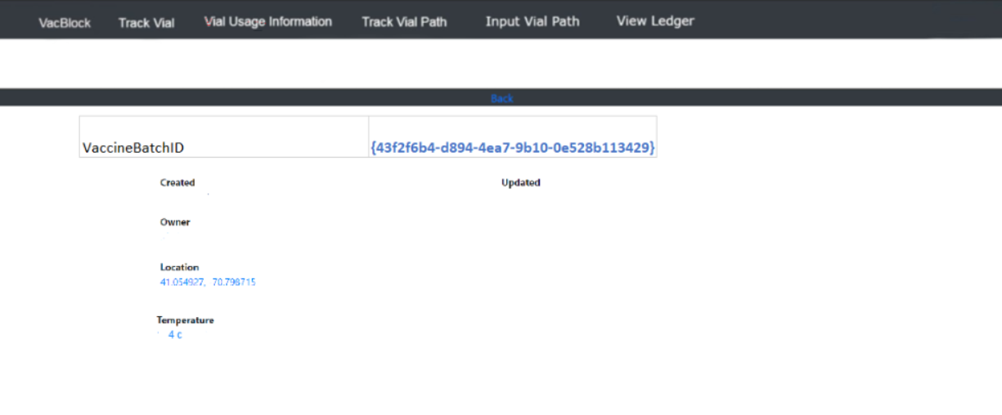

Slide 35
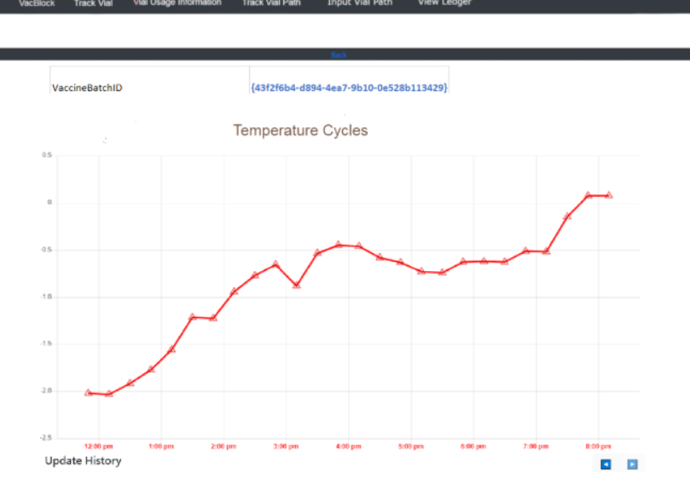

Slide 36
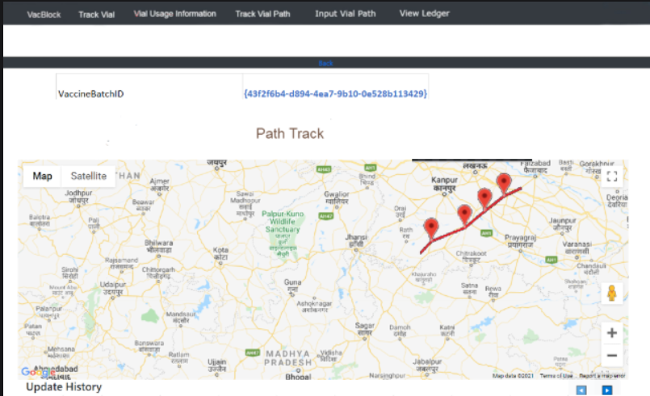

Slide 37
Corresponding App
The current prototype allows the vaccinators and patients to register and log in the app, view the vaccine history and add new records.
Future Development
The App will allow producers, distributors and admins to register and log in the app. The producers will be able to add vaccine stock records are they are produced. Distributors will be able to update the location of the vaccine stock being moved which will be cross checked by the real time location tracking using IOT devices. The Admins will be able to monitor all the information collected by the servers, including manual as well as automated data updations.

Slide 38
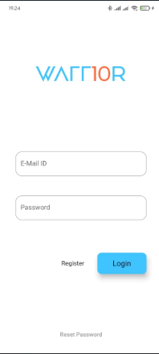
The Login Screen takes email id and password to allow users to register or login to use the app's services.

Slide 39
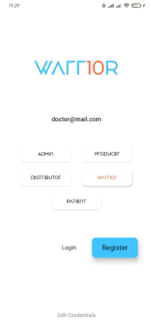
While registering, the user must select a category which the app will use to provide the relevant features once the user is authenticated.

Slide 40
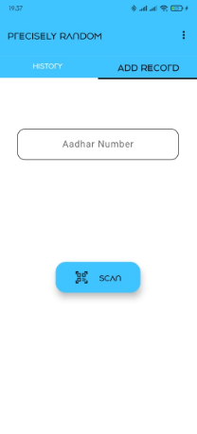
The warriors will have a page to add a record by providing the patient's identification number and scan the qr code from the vial.

Slide 41
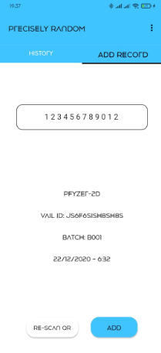
Once scanned, the details of the vial will be displayed before adding the record to the servers.

Slide 42
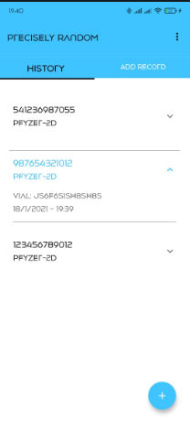
The warriors would be able to view the history of all patients that have been vaccinated by the warrior with details like vial id, vaccine company and name, and timestamp.

Slide 43
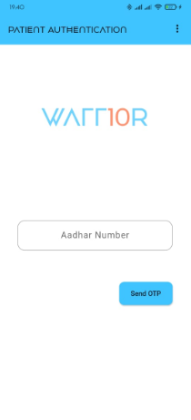
The patient will be authenticated by the Aadhar Card or any Unique Identification Number.

Slide 44
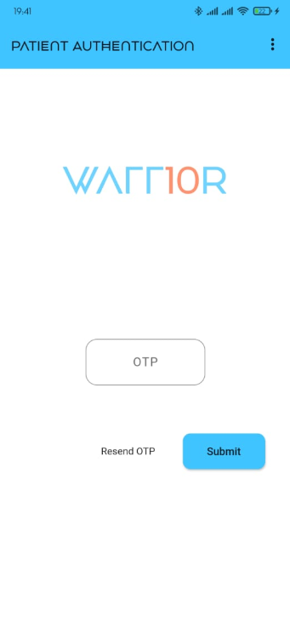
After submitting the Identification Number, an OTP would be sent to the Patient's mobile number linked to the Identification Number like Aadhar Card.

Slide 45
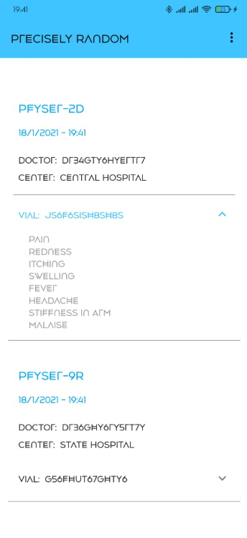
The Patient's Dashboard will display the details of the vaccines that the patient has been injected with, and contain details like Doctor's Id, Vaccination Center, Vial Id and expected side effects (if any).

Slide 46
Our Research on Current Health Structure of India
Double click to access the pdf

Slide 47
Our Research On current Cold chain and Vaccines.
Double click to access the pdf

